Slide 1
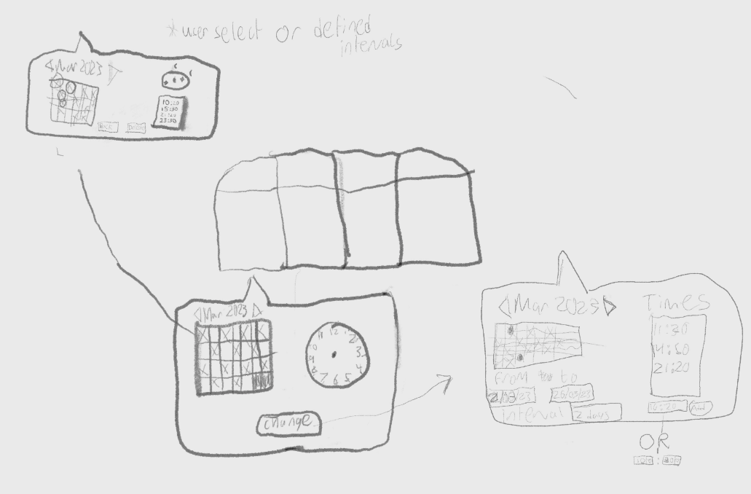
Initial UI Sketch

Slide 2
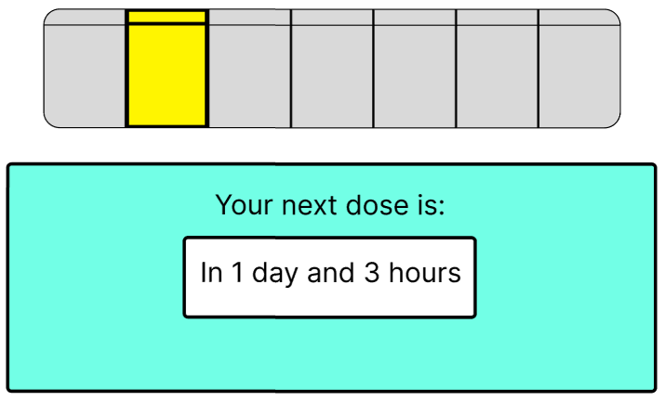
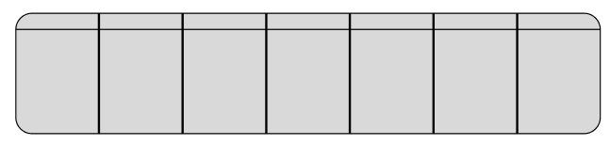
User Interface
Meets user’s mental model
Represents each physical section
Uncomplicated design
Each box holds the day/time of upcoming doses
Selecting a box shows countdown to next dose
Box highlighted in yellow for adequate contrast
Borders of selection emboldened

Slide 3
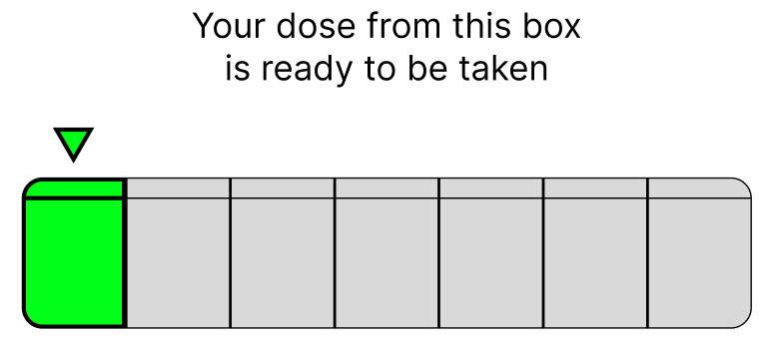
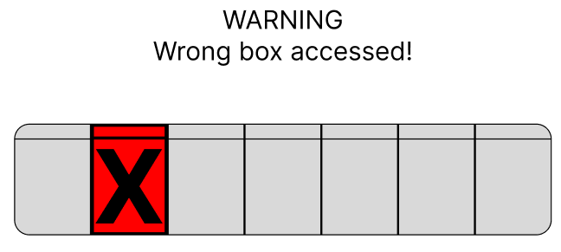
User Interface
Arrow pointing to the box to be accessed
Green box, matching the green LED
Red box to alert user to dangerous action
Large X is an extra indicator of user error
Capital letters and ! draw attention to message

